Slide 1
PSI Global Trade Work
IAMRECON
Education Sector

Slide 2
The new wave of trade agreements
Shift away from multilateral system
FTA’s proliferating – over 2000 since mid 90’s
Regional trade agreements expanding – new plurilaterals
Not transparent – secret, exclusive

Slide 3
Not about tariff’s
97% removal of non-agricultural tariff's
Investors rights
Regulatory coherence
Enforcement - Investor State Dispute Resolution procedures
Notes:
Increasingly about creating rights for MNE investors
Note this often gives them more rights than local companies

Slide 4
Beyond Non-Discrimination
GATS prohibits public monopolies and exclusive service suppliers in committed sectors.
Governments cannot restrict or require “specific types of legal entities” through which to supply services.
applying ‘pro-competitive’ regulation to previously socialized services
Notes:
Normal areas of agreement is to stop government discriminating against foreign providers
But GATS goes further
For example, GATS Article XVI prohibits public monopolies and exclusive service suppliers in fully committed sectors, even on a regional or local level.
ALSO: cant restrict legal form of service providers in fully committed sectors (such as favouring community-based not-for-profits) which are so important in social services, child care, and education.
The GATS also develops templates for pro-competitive regulation, tailored to certain sectors such as telecoms.

Slide 5
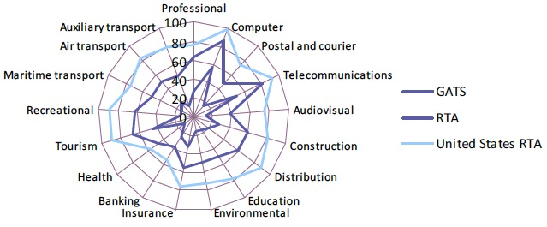
Developing Country Service Commitments:
Much greater in US FTAs than GATS
Source: UNCTAD 2014
Notes:
-

Slide 6
Democracy
Will bind future governments
Negotiations not disclosed to public – mandates, offers, text
Will stop governments from delivering services in accordance with mandate (auto insurance case)
Enforced with penalties - rare
Notes:
1 -More like constitution change than legal change
2 - People outraged if law was made like this locally
3 – flexible provision + future provision
ISDR
Private panels – can be a judge and a party at same time
Rights to investors to sue governments – unheard of
Australian tobacco and plain packaging example
Chill effect

Slide 7
Public Services are not commodities
QPS: Provide basic social and economic necessities universally on the basis of need. Exists because markets will not produce these outcomes.
Trade agreements: deliberately promote commercialisation and define goods and services in terms of their ability to be exploited for profit by global corporations and international service providers.
Notes:
Trade Agreements fundamentally misconceives public services and privilege the profits of the richest in the world over those who have the greatest need.

Slide 8
Constructing Education as an industry
Education export is big and growing business, estimated at over $28 billion in 2005 (Bashir 2007),
If liberalized globallyestimated value of at least $1387 billion (Robertson et al 2007, p.142).
Top five exporting countries were the US, the UK, Australia, Germany and France - all TISA Parties (2008 figures: OECD 2010).

Slide 9
Trade Agreements Effect Public Services
Privatisation
Ability to regulate
Creates corporate rights that challenge state rights

Slide 10
Restrictions on public services
Standstill: confining public services within existing boundaries,
Ratchet: locking in future (failed) privatization and (failed) regulation
Negative list: Future services
Dom regs: Restricting governments options for regulating
Notes:
Future services:
Public services evolve.
Previously: public health systems, public transport systems, public education and public waste and sanitation in many countries.
Future policy challenges such as medicine and biotechnology, climate change related energy and abatement measures, banking re-regulation or internet regulation are likely to require some form off public sector involvement.

Slide 11
Domestic regulation
Binding rules that allow corporations to challenge new or costly regulations – even if domestic and foreign treated the same
Covers qualification requirements, technical standards and licensing requirements
Worker safety, environmental, consumer protection, universal service obligations, water standards, municipal zoning, toxic waste transport, educational institutions etc
Notes:
Quals – professional and trade standards
Tech standrads – rules according to which the service must be performed + tech standards – rules about how patient care must be carried out OR how equipment is to be operated
Licensing requirements – professional licencing but also related to governments permission to companies to provides services ie licencing health facilities and laboratories, waste disposal, broadcast licenses, power plants

Slide 12
Notes:
Needs a new title

Slide 13
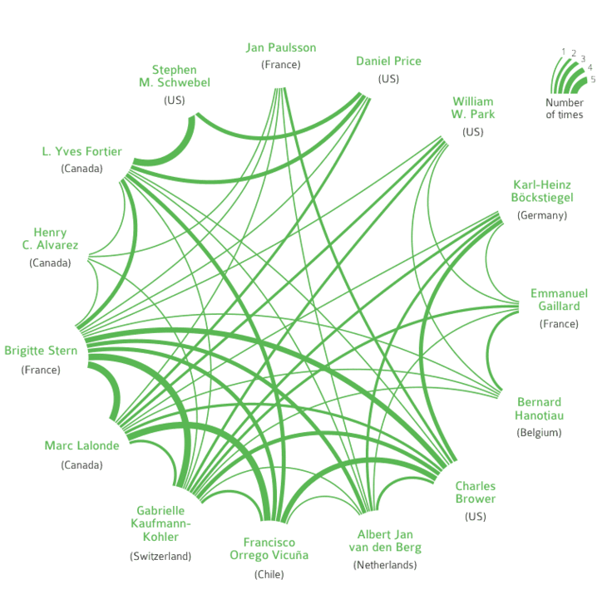
15 arbitrators alone have captured the decision-making in 55% of the total investor-state cases known today
Source: Profiting from Injustice http://corporateeurope.org/publications/profiting-from-injustice

Slide 14
Some of the Investor-State Cases
Attack on Reversal of Water System Privatization
Vivendi v. Argentina: 2007 (France-Argentina BIT). Argentina ordered to pay $105M to firm that cut off water to Buenos Aries. Contract dispute over U.S. $$-denominated rate guarantees unpayable in financial crisis.
Attack on Post-revolution Increase in Egypt’s Minimum Wage
Veolia vs Egypt: June 2012 (France-Egypt BIT). The company argues that changes to local labor laws – including recent increases in minimum wages – have impacted negatively on the company despite contract provisions designed to buffer the concessionaire from the financial implications of any such legal changes.
Attack on South Africa’s Black Economic Empowerment Policy
Piero Foresti & Others v. South Africa: Mining investors claim South Africa’s Black Economic Empowerment law violated investment treaties even though it implemented new South African constitution post-Apartheid.
Attack on Canadian medicine patent policy by Eli Lilly
$500M claim because Canadian high court invalidated patents on 2 drugs that didn’t perform as filed
Attack on Canadian Toxic Chemical Ban
Ethyl v. Canada – ban reversed, corp. paid $13M for lost profits while ban was in effect – US states ban same chemical, MMT a gasoline additive
Attack on Australian, Uruguayan Cigarette Health Laws by Phillip Morris
Chevron Attacks Ecuador to halt court-ordered payment for Amazon pollution

Slide 15
Insufficient carve-out for public services
GATS excludes services provided “in the exercise of governmental authority.”
defined as “any service which is supplied neither on a commercial basis nor in competition with one or more service suppliers.”
Notes:
If left to governments to define would not be problem
But defined very narrowly
Major problem with “in competition with one or more service suppliers”
most public service systems involve a tightly regulated mix of - public, not-for-profit, and private - financing and delivery.
Recent interpretation shows only safe areas are (police and judiciary, prisons, statutory social security schemes, border security, air traffic control, etc.), which are currently of no commercial interest (EC reflections papwer 2011)

Slide 16
PSI Work
TTIP
TTP
TISA
And how it effects public education

Slide 17
Why a TISA?
Services Sector growth
2/3 of GDP but 20% of trade
Doha round at a standstill
GATS incomplete – TISA extends GATS
Aim to pressure other countries to join after conclusion
Notes:
Add stats
Corporate lobbying – epseically in America – Services Industries Association

Slide 18
Who does it cover?
Canada, Chili, Colombia, Costa Rica, Mexico, Panama, Peru, United States
Australia, Hong Kong, Japan, New Zealand, Pakistan, South Korea, Taiwan
Iceland, Norway, Switzerland, 28 members of the EU
Turkey, Israel
60% of worlds services
Notes:
Really Good Friends of Services
Gold standard
Large coverage of world economy
Forcing countries to join after it has been negotiated
China is latest country to announce joining talks – quite significant

Slide 19
History of TISA
Started in early 2013
Secret negotiations in Geneva every 8 weeks

Slide 20
Who wants the TISA?
The Global Services Coalition in a letter to the European Commission explains that the TISA was conceived:
“to allay business frustration over the stalled Doha Round outcomes on services.” (September 10, 2013).
Notes:
http://www.esf.be/new/wp-content/uploads/2013/10/GSC-Letter-on-TISA-to-Karel-de-Gucht1.pdf

Slide 21
The US Coalition of Service Industries (CSI) set up a TeamTISA to promote TISA
Microsoft
JP Morgan Chase
CHUBB
Deloitte
UPS
Google
Verizon
Walmart
Walt Disney
IBM
and more.

Slide 22
What types of things do they want?
Walmart in its submissions to the US Trade Representative (USTR) sees the TISA as a way to free itself of restrictions on the sale of pharmaceuticals, medical devices, alcohol and tobacco and avoid zoning laws
FEDEX in its submissions to the USTR seeks the elimination of “regulatory advantages historically conferred on national post offices”. In other words it sees the TISA as a way to force the deregulation of the postal system.
Notes:
http://www.teamtisa.org/
http://www.teamtisa.org/index.php/about-team-tisa/coalition-members
http://wikileaks.org/tisa-financial/
Testimony, Walmart, “Walmart ISA Comments 2013”, response to USTR “Request For Comments On An International Services Agreement” Docket Number: USTR–2013–0001. Online at: http://www.regulations.gov/#!documentDetail;D=USTR-2013-0001-0028
FedEx, response to USTR “Request For Comments On An International Services Agreement” Docket Number: USTR–2013–0001. 25 February, 2013. Online at: http://www.regulations.gov/#!documentDetail;D=USTR-2013-0001-0007

Slide 23
What services does it cover?
cross border services (GATS Mode 1) E-learning, online education services;
consumption abroad (GATS Mode 2) overseas students;
foreign direct investment (GATS Mode 3) multinational corporations buying or establishing schools, universities, training facilities etc.
temporary movement of persons (GATS Mode 4) such as teachers, teachers assistants, administrative and executive staff temporarily travel abroad to provide services.
Notes:
Only 1 mode is actually about trade in services – MODE 1

Slide 24
Potential TISA Impacts: Education
Expansion of private providers
Absolute limits, or regulation on for-profit providers (quality, qualifications etc) could be challenged as a barrier to market access.

Slide 25
Potential TISA Impacts: Education
“Discriminatory” domestic subsidies
Public education subsidies would have to be shared on an equal basis between foreign and domestic institutions in the education market.

Slide 26
Potential TISA Impacts: Education
Lower wages and working conditions for educators
Proponents of distance learning argue that it can help “reduce spiraling costs by ..creating less teacher-dependent methods of teaching and learning.”
Many countries have specified that they want Mode 4 access in higher education.

Slide 27
Potential TISA Impacts: Education
Necessity test: Regulation can’t be more burdensome than necessary.
Requirements that:
tests be marked in the jurisdiction
teaching must be in person, and
Frequency of inspections
could be all challenged

Slide 28
Potential TISA Impacts: Education
No cross subsidies via licensing provisions
Licensing can only cover the cost of issuing the license and enforcing it
Can not use licensing fees for private providers to subsidize public provision

Slide 29
Trans-Pacific Partnership (TPP)
Notes:
As you can see there is a mixture of developed and developing nations involved in the TPP

Slide 30
Notes:
US companies, some of whom have access to the text of the negotiations, are lobbying hard for the TPP.
This graph, from the Sunlight Organisation, shows that the US pharma are the biggest lobbyists by far

Slide 31
TPP - Effects on Education
Restrictions on copying of text books (IP)
Difficult to prohibit educational provider on quality grounds (market access)
ISDS – squeeze budgets

Slide 32
TPP – Effects on Education
State owned enterprises and foreign competition (subsidies)
Government procurement – local purchasing
Regulatory coherence – greater role for industry in policy making

Slide 33
Over-reach: Mood is changing
AFL-CIO
ETUC
TUC
DGB
Civil Society
Washington Forum
TISA Forum

Slide 34
What to do?
Understand how the agreements effect your members
Understand how they effect workers and democracy
Explain more than tariffs and trade
Work with civil society allies
Reach out to private sector unions
Influence your national centre
Lobby your government

