Slide 1
Tax Justice, Inequality and Public Services
Daniel Bertossa
Director Policy
Public Services International
Notes:
Thankyou for having me here
Thank Bernard + other unions?????
PSI focus on tax justice - driving global labour interest
reaching out to all workers who benefit – private sector unions
Civil society – like all our issues - we need to work with users of services - workers and citizens
FES is special as it takes deep interest in injustice and globalisation
FES - Broader perspective and link people - THANKYOU

Slide 2
Inequality – Getting worse
Top 1% own 46% of global assets
Richest 10% own 86% of global assets
US$ 10 Trillion in tax havens from poor countries

Slide 3
Inequality: Effects
Economically inefficient
Socially divisive
Morally unjustifiable
Politically corrosive – corruption: secrecy + power
Notes:
Limit to how many yachts
Poor spend more – demand
GFC – caused by inequality – same as great depression – debt to spend
Money distorts power – lobbying – privatisation
Less opportunity for very poor – less chance of using potential
Elites buy services to keep elite – education, land, power

Slide 4
Corporations not paying fair share
US profits tripled to $US1,200 bill (1990 to 2010)
Profits globally 25% GDP (1983) to 35% (2008)
Global corporate income tax halved to 2.4% (2008)
Notes:
From 1990 – even after GFC
Most corporations artificially lower profits declared
So as profits up by 50% - tax paid was halved

Slide 5
Massive avoidance
Tax Losses: UK (30 Billion) Germany (40 Billion) USA (100 Billion)
US$ 100 billion annually lost to developing countries
If Corporations paid there taxes in Africa the increase would be more than the total inflow of aid
Notes:
Tax collected from Corporations in Africa – twice global aid budget
Double revenue AND independent – aid tied to trade for developed contries

Slide 6
Giant corporations that have almost stopped paying taxes in selected years
General Electric; Boeing; Exxon Mobil; Verizon; Kraft Foods; Citigroup; Dow Chemical; IBM; FedEx; Honeywell; Apple; Pfizer; Google; Microsoft; Merck
Notes:
Figures from Citizens for Tax Justice – for more information see http://ctj.org/
Figures are for selected years from 2008

Slide 7
InterAmericas
Loss of tax revenue as a % of gov revenue
Costa Rica - 27%
Honduras - 22%
Panama - 14%

Slide 8
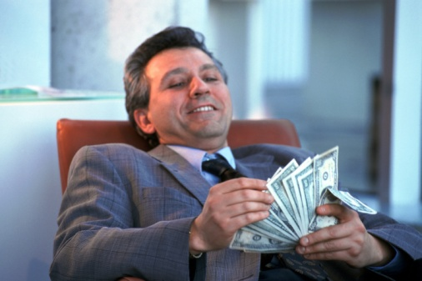
Tax is political
There’s class warfare, all right,
but it’s my class, the rich class, that’s making war,
and we’re winning.
-Warren Buffet (world’s third wealthiest person in 2011)

Slide 9
Tax is Political – Not technical
Solutions exist
Winners and losers
Politics and interests
Have the debate
Notes:
Have the debate – the winners dont want to talk about it
Focus on who is not paying there fair share

Slide 10
The debate
Focus on the injustice
Show who benefits
Link to corruption
Don’t accept tax competition
The link to investment

Slide 11
PSI Campaign 1- OECD/ G20 BEPS
Majority of all tax avoidance globally is by using one simple trick
Global corporate tax rules written in 1920’s
Half of global trade within corporations
By manipulating the prices paid between companies can shift profits to tax havens
Rules being rewritten by OECD for G20

Slide 12
PSI Campaign 2 ICRICT
Independent Commission on Reform of International Corporate Taxation
Provide alternative to debate
Jose Ocampo, Joseph Stiglitz, Magdelana Sepulveda
http://www.icrict.org/

Slide 13
Work 3: Financing for Development
Linked to Sustainable development goals
Addis Ababa in July
PSI work on privatisation and PPP BUT Tax as well

Slide 14
National and Regional Campaigns
Tax holidays
Progressive taxation
Corporate taxation
Wealth and property taxes

Slide 15
Upcoming PSI Activities
May Day – Workers pay taxes
Global Public Services Day: 23 June – Country gap reports
G20 Labour Tax Forum: 16 – 18 September in Geneva
G20/ L20 – Get on your national centres delegation

