Slide 2
v
Peopleoverprof.it
IS AN ONLINE KNOWLEDGE LIBRARY AND CAMPAIGN BUILDER FOR FIGHTING PRIVATISATION OF PUBLIC GOODS

Slide 3
v
Goals

Slide 4
Connect organisations
fighting privatisation
v
WITH NUMEROUS ORGANISATIONS AND MEDIA SOURCES WORLDWIDE, OUR STRUGGLE NEEDS STRONG LEADERSHIP

Slide 5
Provide & share
global best practices
v
WITH NUMEROUS ORGANISATIONS AND MEDIA SOURCES WORLDWIDE,INFORMATION IS DISPERSED AND INCOHERENT

Slide 6
Analyse & foresee privatisation trends
v
VERY OFTEN THOSE DRIVING THE PRIVATISATION PROCESS ARE THE SAME COMPANIES, ACCORDING TO SECTOR, WITH THE SUPPORT OF REGIONAL AND GLOBAL INVESTMENT BANKS.

Slide 7
Empower
campaigners
v
THERE IS LACK OF ONLINE SERVICES FOR LAUNCHING
AND MANAGING CAMPAIGNS WITH CLEAR ACTIONS

Slide 8
CURRENT STATE OF AFFAIRS

Slide 9
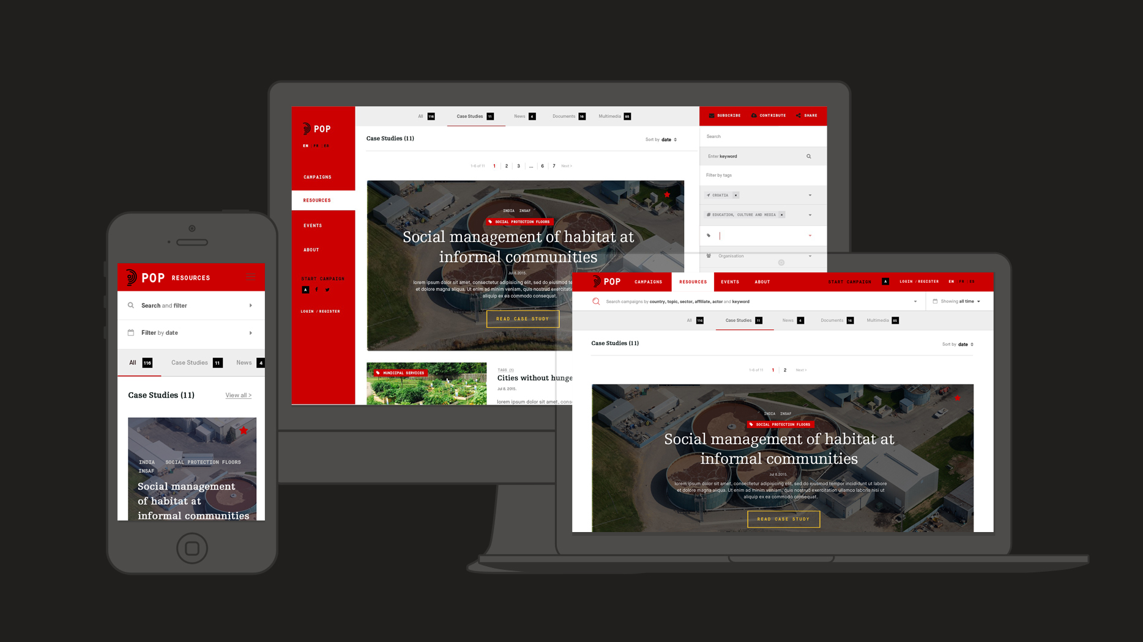

Slide 10
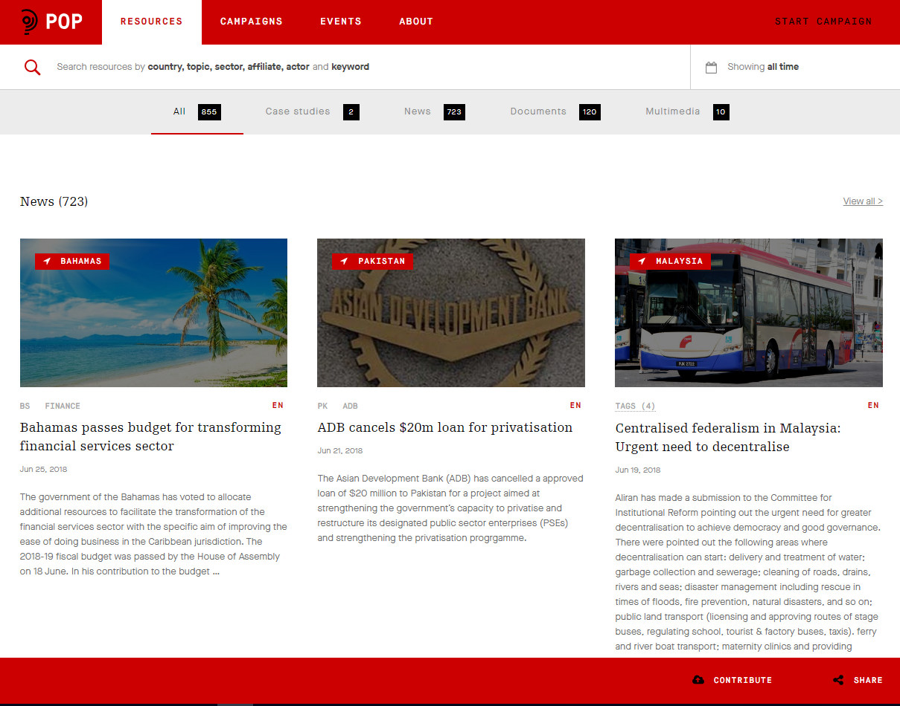
RESOURCES – NUMEROUS DOCUMENTS, NEWS & MULTIMEDIA FILES ARE ALREADY IN THE KNOWLEDGE BASE

Slide 11
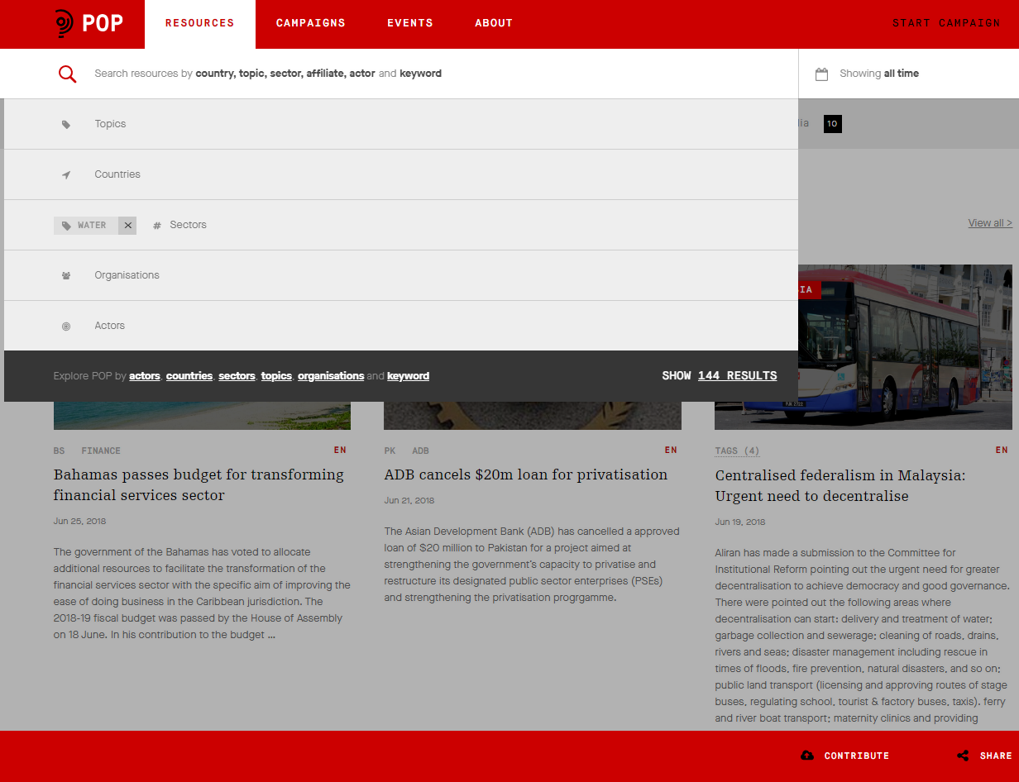
RESOURCES – USE THE SEARCH FILTERS TO CROSS REFERENCE

Slide 12
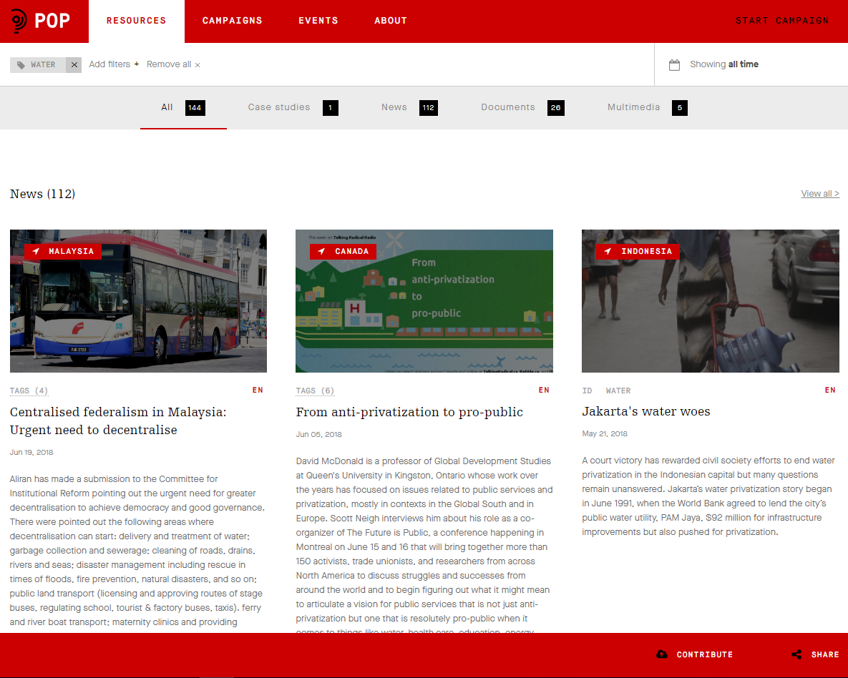
RESOURCES – FIND ALL RESOURCES BY SECTOR OR COUNTRY

Slide 13
EVENTS – FEATURED EVENTS

Slide 14
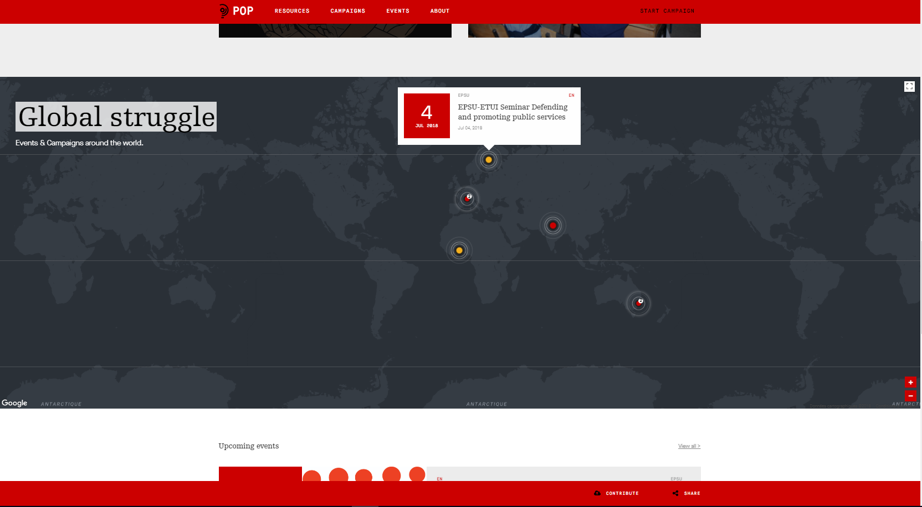
EVENTS – SPOTLIGHT ON SUSTAINABLE DEV. REPORT: GENEVA LAUNCH

Slide 15
CAMPAIGN – TAKING BACK CONTROL

Slide 16
Contribute
your resources
v
EASILY ADD A RESOURCE - HELP GROW THE LIBRARY
PROVIDE A LINK, TO DOCUMENTS AND ARTICLES
WE AUTOMATICALLY SCRAPE CONTENT

Slide 17
EASILY CONTRIBUTE YOUR OWN RESOURCES AND MAKE THE
LIBRARY GROW

Slide 18
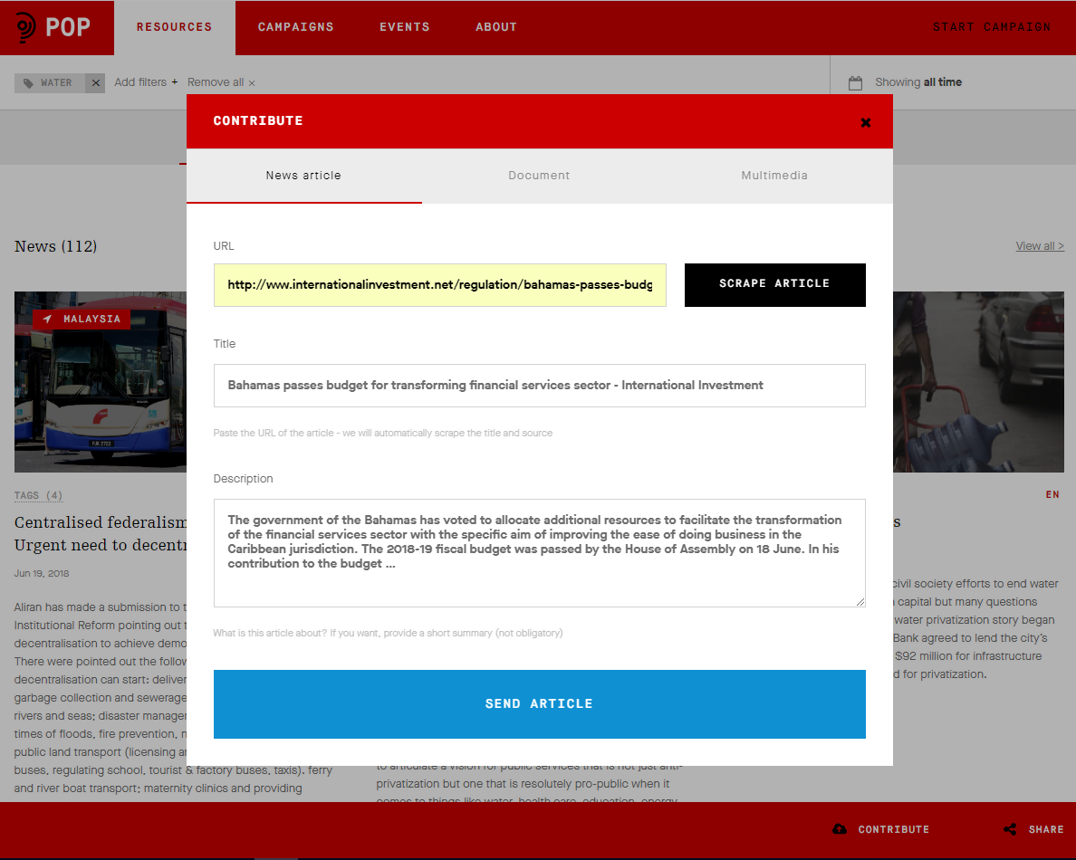
PASTE A LINK – CONTENT IS SCRAPED AUTOMATICALLY

Slide 19
Launch and manage campaigns
v
v
REGISTER TO USE DRAG AND DROP BUILDER
CHOOSE DIFFERENT ACTIONS FOR YOUR CAMPAIGN
REQUEST ENDORSEMENT FROM OTHER ORGANISATIONS
PUBLISH IN CLICK AND USE CUSTOM URL
TRACK UPDATE AND MANAGE
EXPORT AND ACT FURTHER

Slide 20
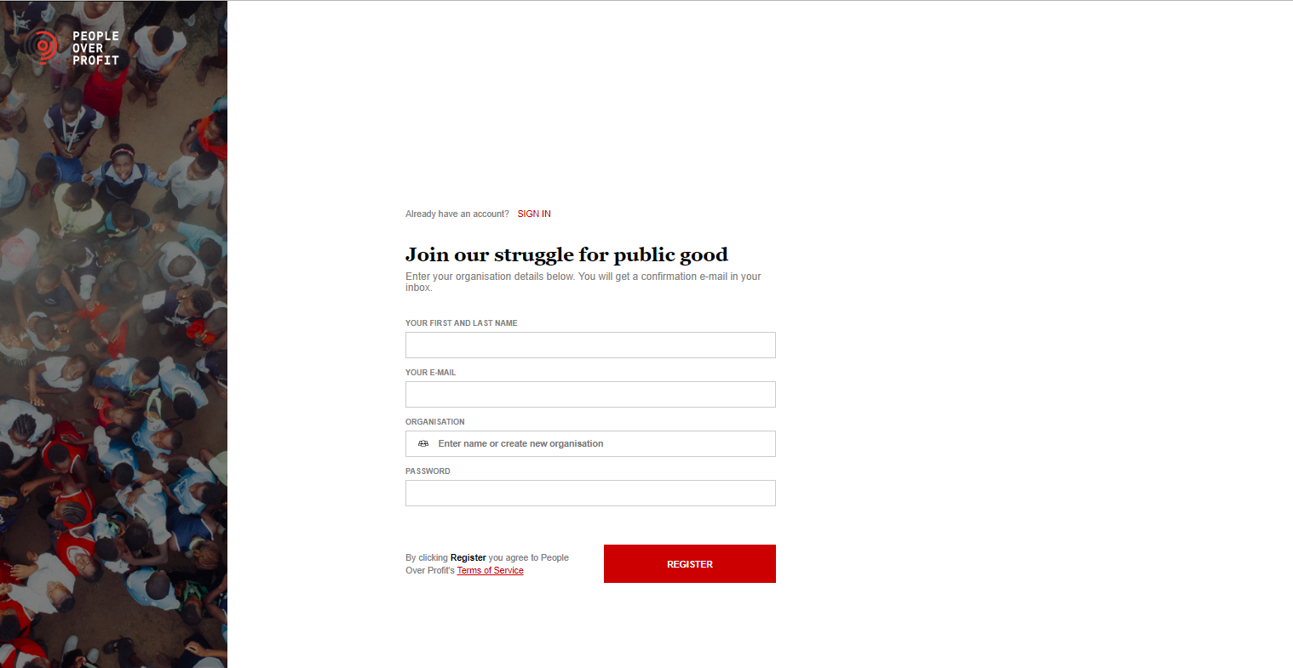
FREELY REGISTER TO START BUILDING AND MANAGING YOUR CAMPAIGNS AND ADD RESOURCES TO POP LIBRARY

Slide 21
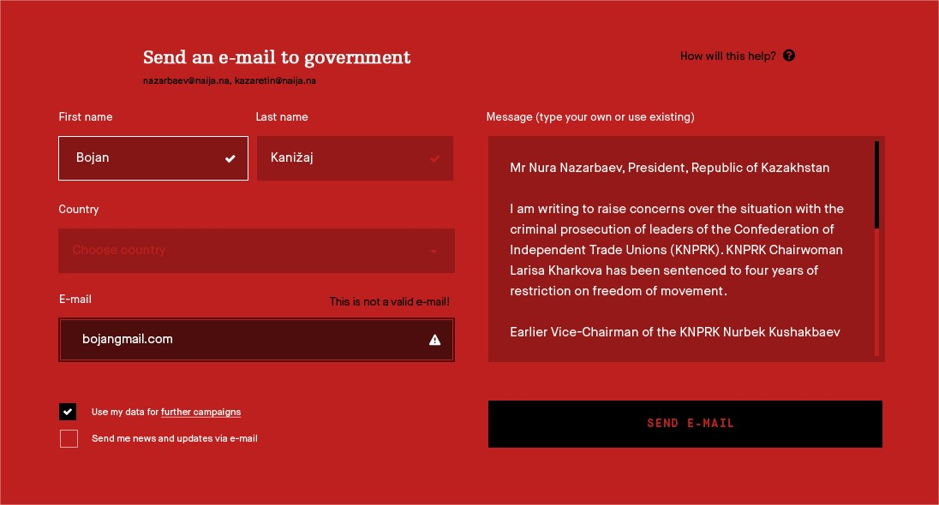
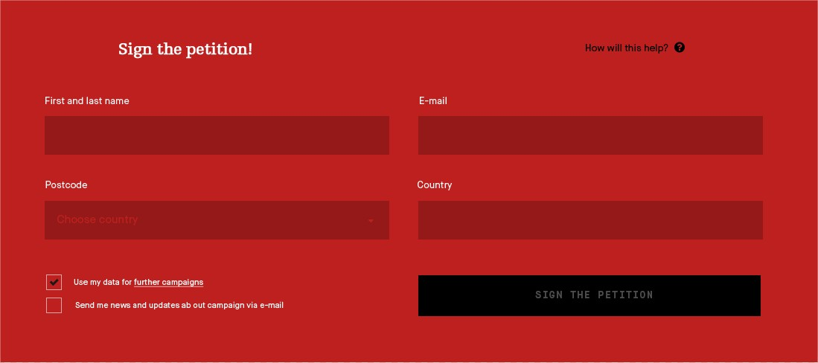
CHOOSE DIFFERENT CALL TO ACTIONS ON YOUR CAMPAIGNS

Slide 22
Subscribe t
to Privatization Watch
v
PRIVATIZATION WATCH
THE GLOBAL NEWSLETTER ON PRIVATISATION OF PUBLIC SERVICES
AVAILABLE IN ENGLISH, FRENCH AND SPANISH

Slide 23
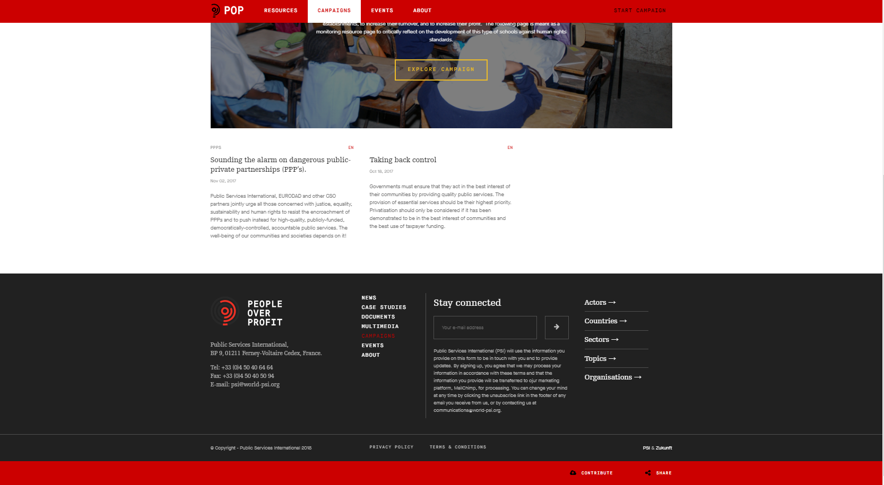
STAY CONNECTED – SUBSCRIBE TO PRIVATIZATION WATCH AND GET THE LATEST GLOBAL NEWS ON PRIVATISATION IN YOUR INBOX

Slide 24
peopleoverprof.it
v
REGISTER TODAY

Slide 25
Contact campaigns@world-psi.org for support
Daniel.Bertossa@world-psi.org

